Slide 1
CSM 357
Human-Computer Interaction lecture 4: Interaction Design
Rose-Mary Owusuaa Mensah Gyening

Slide 2
Overview
In this chapter we will think about interaction design.
Note that we are not just thinking about the design of interactive systems, but about the interaction itself.
Scenario
An office has just got a new electric stapler. It is connected to the mains electricity and is hard to move around, so when you want to staple papers together you go to the stapler. In the past when someone wanted to staple things they would take the stapler to their desk and keep it until someone else wanted it. You might write a letter, print it, staple it, write the next letter, staple it, and so on. Now you have to take the letters to be stapled across the office, so instead you write–print, write–print until you have a pile of things to staple and then take them across. The stapler influences the whole pattern of interaction

Slide 3
Interaction Design
So, interaction design is not just about the artifact that is produced, whether a physical device or a computer program, but about understanding and choosing how that is going to affect the way people work.

Slide 4
The golden rule of design
For Human–Computer Interaction, the obvious materials are the human and the computer.
That is we must:
understand computers
– limitations, capacities, tools, platforms
understand people
– psychological, social aspects, human error.

Slide 5
The process of design
Often HCI professionals complain that they are called in too late.
A system has been designed and built, and only when it proves unusable do they think to ask how to do it right!
In some companies, people “assume” usability is equivalent to testing – checking whether people can use it and fixing problems, rather than making sure they can from the beginning.
In the best companies, however, usability is designed in from the start.

Slide 6
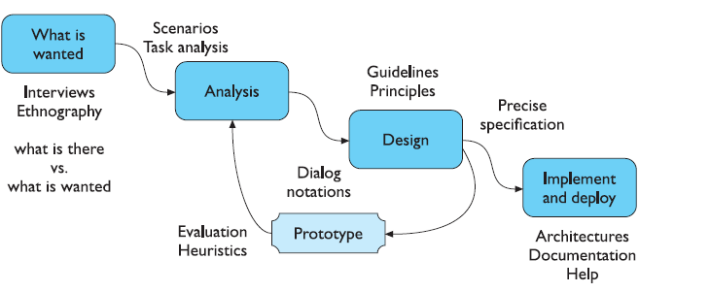
Interaction Design Process
Figure 1: Interaction Design process

Slide 7
Interaction Design Process: Requirement Analysis and Specification (Stage 1)
Generally, each iteration of the interaction design approach involves four distinct phases.
First, designers working in teams try to understand the context in which users may use a system.
Then, they identify and specify the users’ requirements
In most cases, the user requirements cannot all be fixed at the beginning of the project.
You have to be prepared to identify new requirements and to refine or reject the existing ones throughout the design process.

Slide 8
Interaction Design Process : Requirement Analysis and Specification
In interaction design, the user and organizational requirements should:
    define the range of relevant users;
    set user centered design goals;
    define priorities of the different requirements;
    provide measurable usability criteria;
    be confirmed by the users or their representatives;
    include statutory or legislative requirements;
    be adequately documented;
    be a working document, which will be updated throughout the design process (a design rationale).

Slide 9
Requirement Analysis and Specification: Commonly used methods and tools
The following methods present different ways of collecting information on the users and the context of use which can be useful in defining initial user requirements.
Interviews: Interviewing is still the most widely used method of learning about the users and what they want. There are 3 types of interviews: unstructured interviews, semi structured interviews and structured interviews.
Observation: Observation is a method where an investigator views users as they work and takes notes on the activities that take place. Observation may be either direct, where the investigator is actually present during the task, or indirect, where the task is viewed by some other means such as video.

Slide 10
Requirement Analysis and Specification: Commonly used methods and tools
Contextual Inquiry: Contextual Inquiry is based on ethnography and the sociological research tradition where the researcher/observer visits the users’ own environment. The observer not only observes the user but also asks questions about events that are not obvious as such.

Slide 11
Requirement Analysis and Specification: Commonly used methods and tools
Brainstorming: The idea of brainstorming is to let people come together and inspire to generate new ideas by opening the mind to any idea that is suggested, allowing freedom for creativity. Brainstorming can be used for rapid generation of ideas or identification of problems in a specific domain.
Evaluation of the usage of corresponding products: Sometimes a good source of information for user requirements is the evaluation of previous products. By studying how people deal with these products you can identify problems with current solutions, needs for new features and ideas for further development. The evaluation can be carried out, e.g., as usability testing in laboratory

Slide 12
User Focus
Over time, many people are affected directly or indirectly by a system and these people are called stakeholders. So, how do you get to know your users? Who are they?
the first thing to find out is who your users are.
Are they young or old, experienced computer users or novices? Sometimes it may not be obvious who the users are
This question becomes harder to answer if you are designing generic software, such as a word processor, as there are many different users with different purposes and characteristics.
A similar problem arises with many websites where the potential visitors are far from homogenous.

Slide 13
User Focus: Talk to Users
It is hard to get yourself inside someone else’s head, so the best thing is usually to ask them. This can take many forms: structured interviews about their job or life, open-ended discussions, or bringing the potential users fully into the design process.
By involving users throughout the design process, it is possible to get a deep knowledge of their work context and needs.
The obvious effect of this is that it produces better designs.

Slide 14
User Focus: Watch the Users
Although what people tell you is of the utmost importance, it is not the whole story.
Because of this, it is important to watch what people do as well as hear what they say.
This may involve sitting and taking notes of how they spend a day, watching particular activities, using a video camera or tape recorder.
It can be done in an informal manner or using developed methods such as ethnography or contextual inquiry

Slide 15
User Focus: Watch the Users
Assignment: In not less than 200 words, describe how ethnography and contextual inquiry can be used observe and collect data on interactions between people and their environment.
look at the artifacts they are using and creating. Look at a typical desk in an office. There are papers, letters, files, a computer, sticky notes, etc

Slide 16
User Focus: Use your imagination
Even if you would like to involve many users throughout your design exercise this will not always be possible.
It may be too costly, it may be hard to get time with them (e.g. hospital consultant), it may be that there are just too many (e.g. the web).
However, even if you cannot involve actual users you can at least try to imagine their experiences.
this is very dangerous! It would be easy to think, ‘if I were a warehouse manager I would do this’. The issue is not what you would do in the user’s shoes but what they would do.
This requires almost a kind of acting

Slide 17
User Focus: Use your imagination (Personas)
Imagine being a warehouse manager. What does the word ‘undo’ in the menu mean to him?
One method that has been quite successful in helping design teams produce user-focused designs is the persona.
A persona is a rich picture of an imaginary person who represents your core user group.
A design team will have several of these personae covering different types of intended users and different roles.
The personae will themselves be based on studies of actual users, observation, etc.

Slide 18
Stage 2 of Interaction Design Process: Analysis
The results of observation and interview need to be ordered in some way to bring out key issues and communicate with later stages of design.
Task models can be used at this stage
Task models are a means to capture how people carry out the various tasks that are part of their work and life.
Scenarios can also be used at the analysis stage
scenarios, rich stories of interaction, which can be used in conjunction with a method like task analysis or on their own to record and make vivid actual interaction.
These techniques can be used both to represent the situation as it is and also the desired situation.

Slide 19
Design

Slide 20
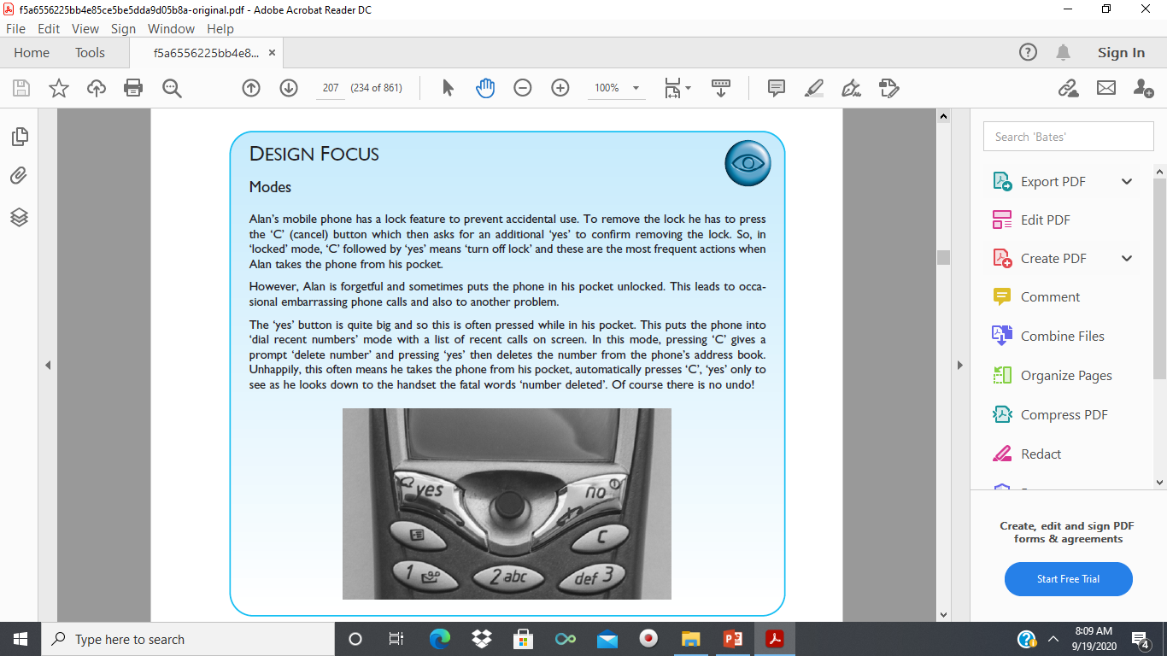
Design Issues
Do you understand the scenario on this slide?
What do you think can be done to prevent accidental deletes?

Slide 21
Screen Design and Layout
A single screen image often has to present information clearly and also act as the locus for interacting with the system. This is a complex area, involving some of the psychological understanding of users
The basic principles at the screen level design comprise the following:
  Ask: What is the user doing?
  Think: What information is required? What comparisons may the user need to make? In what order are things likely to be needed?
  Design: Form follows function: let the required interactions drive the layout.

Slide 22
Navigation Design
The place to start when considering the structure of an application is to think about actual use:
  who is going to use the application?
  how do they think about it?
  what will they do with it?
This can then drive the second task – thinking about structure.
Here we will consider two main kinds of issue:
  local structure: looking from one screen or page
  global structure: structure of site, movement between screens.

Slide 23
Navigation Design: Local Structure
Much of interaction involves goal-seeking behavior.
Users have some idea of what they are after and a partial model of the system. In an ideal world if users had perfect knowledge of what they wanted and how the system worked they could simply take the shortest path to what they want, pressing all the right buttons and links.
However, in a world of partial knowledge users meander through the system.
At each point in the interaction, users should be able to make assessment of whether they are getting closer to their (often partially formed) goal.

Slide 24
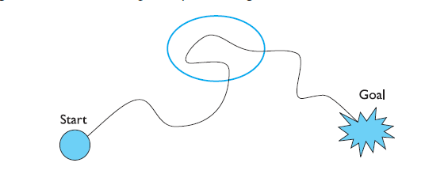
Navigation Design: Local Structure (Avoid this!)

Slide 25
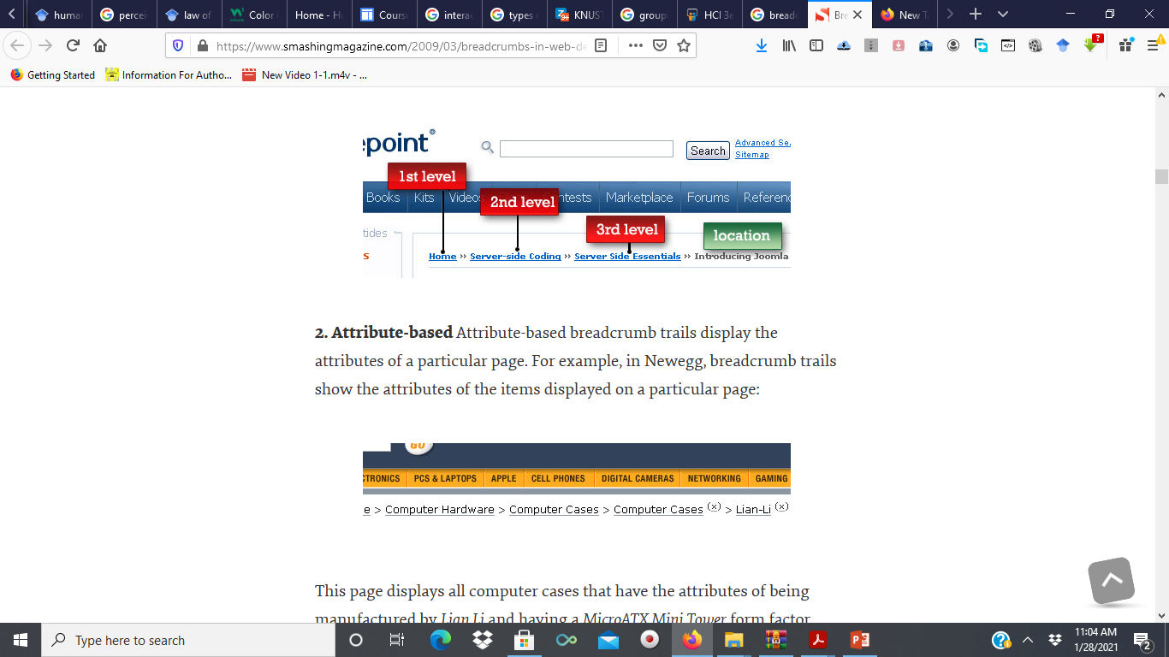
Navigation Design: Local Structure
To do this goal seeking, each state of the system or each screen needs to give the user enough knowledge of what to do to get closer to their goal.
The screen, web page or device displays should make clear where you are in terms of the interaction or state of the system.
Some websites show ‘bread crumbs’ at the top of the screen, the path of titles showing where the page is in the site
Breadcrumbs example

Slide 26
Video group presentation
Breadcrumbs In Software (Desktop, mobile and web) Design: Examples, design guidelines and Best Practices

Slide 27
Navigation Design: Links
Some web pages are particularly bad in that it is unclear which images are pure decoration and which are links to take you somewhere.
On the web, the standard underlined links make it clear which text is clickable and which is not.
However, in order to improve the appearance of the page, many sites change the color of links and may remove the underline too.
Be consistent
This is especially confusing if underline is then used as simple emphasis on words that are not links!

Slide 28
Navigation Design: Global structure – hierarchical organization
The overall structure of an application represents the way various screens, pages or device states link to one another.
One way to organize a system is in some form of hierarchy.
This is typically organized along functional boundaries (that is, different kinds of things), but may be organized by roles or user type
The hierarchy links screens, pages or states in logical groupings.

Slide 29
Screen Design and Layout
If things logically belong together, then we should normally physically group them together. This may involve multiple levels of structure.
For example, when collecting information from customers during a purchase order, we can use multiple levels of structure as shown below.
  Order Details:
    Administrative information
        Billing details
        Delivery details
  Order information
        Order line 1
        Order line 2

Slide 30
Order of groups and items
If we look at multiple levels structure on the previous slide again, we can see that the screen seems to naturally suggest reading or filling in the billing details first, followed by the delivery details, followed by the individual order items. Is this the right order?
In general we need to think: what is the natural order for the user?
This should normally match the order form provided on a screen.
For data entry forms or dialog boxes we should also set up the order in which the tab key moves between fields.

Slide 31
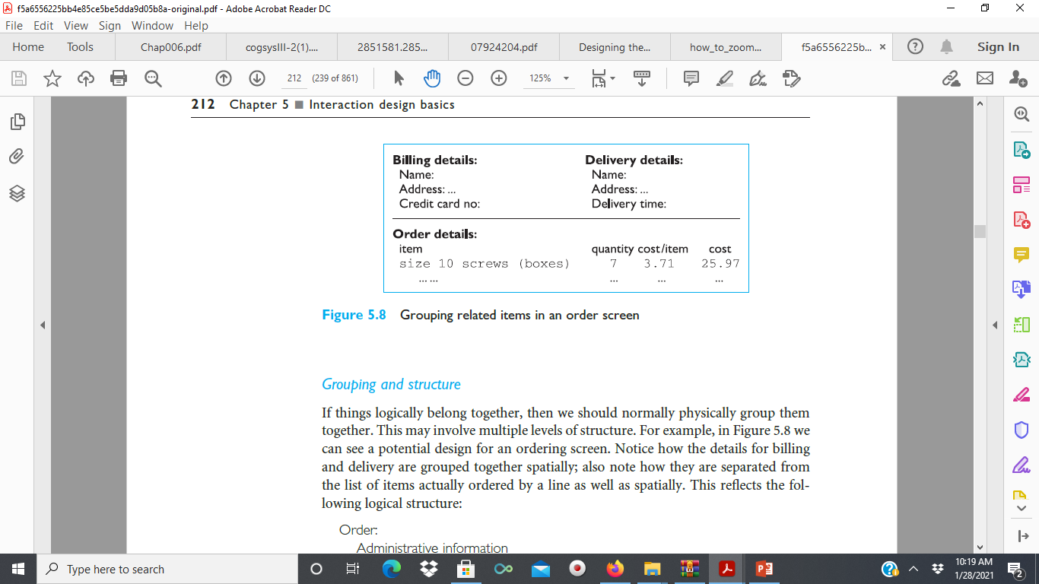
Decoration
looking at Figure 3, we can see how the design uses boxes and a separating line to make the grouping clear.
Other decorative features like font style, and text or background colors can be used to emphasize groupings.
Figure 3: Grouping related items in an order screen

Slide 32
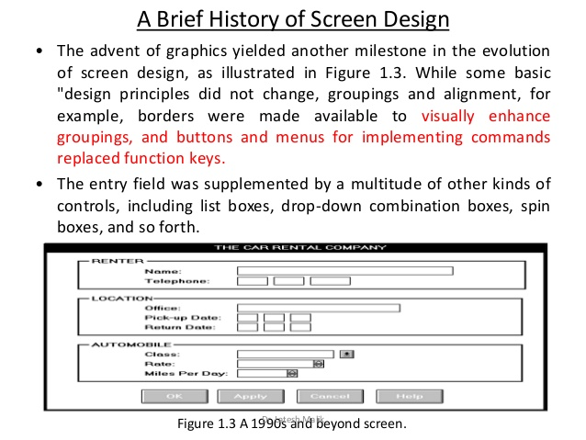
Decoration
design boxes and separating lines can be used to make the grouping clear.
Other decorative features like font style, and text or background colors can be used to emphasize groupings.
For example, the form shown below uses multiple levels structure and design boxes to group items under renter, location and automobile

Slide 33
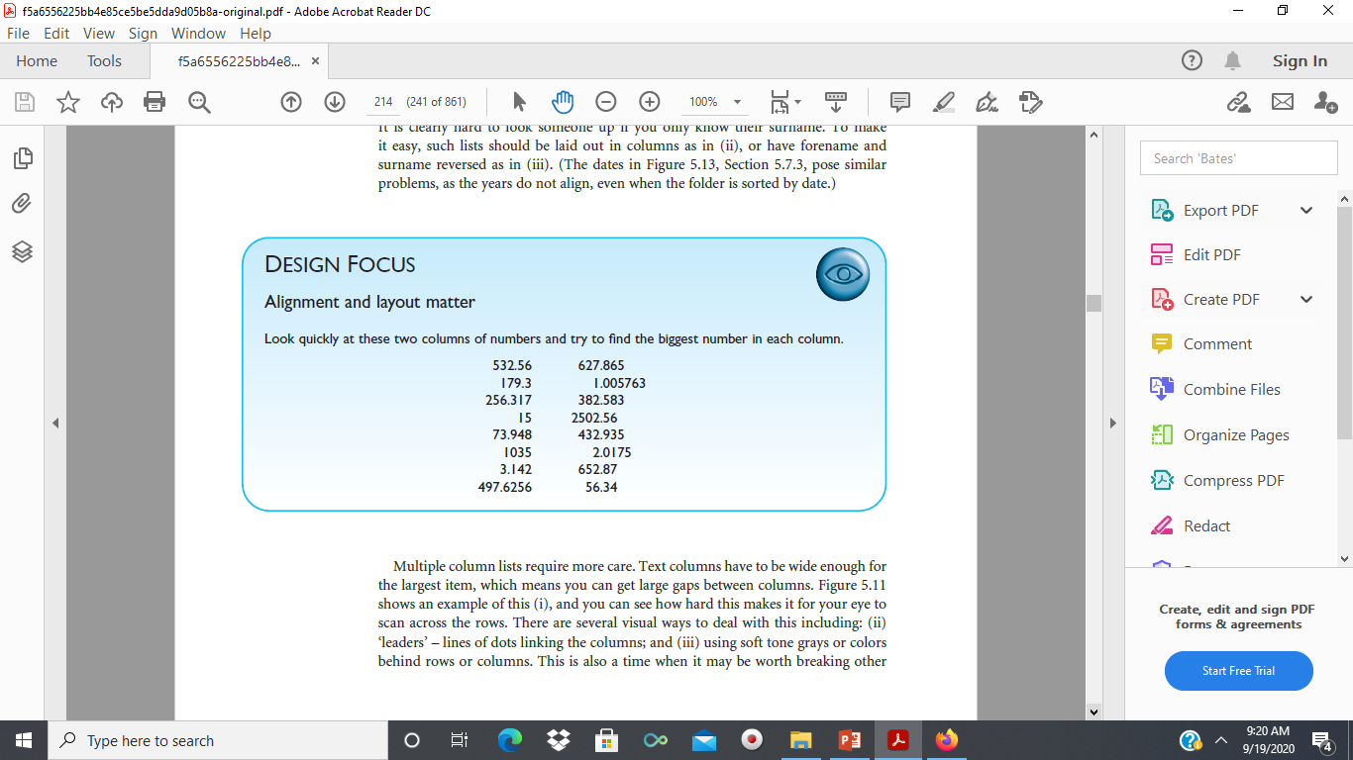
Alignment
Alignment of lists is also very important. For users who read text from left to right, lists of text items should normally be aligned to the left.
Numbers, however, should normally be aligned to the right (for integers) or at the decimal point.

Slide 34
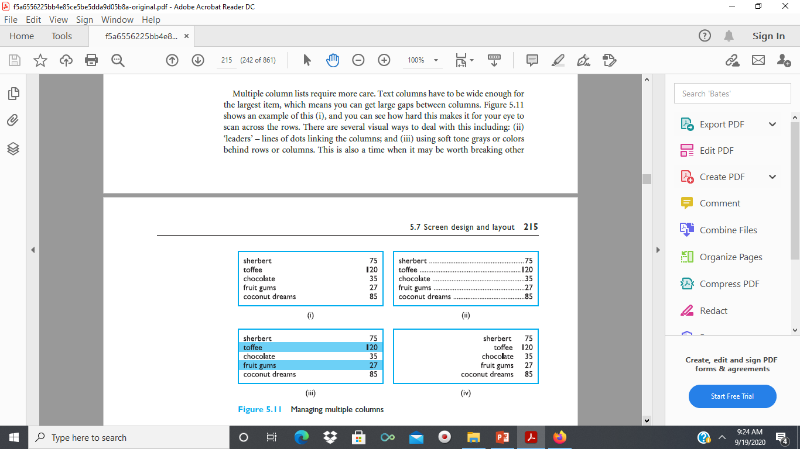
Dealing with multiple columns
Multiple column lists require more care.
Text columns have to be wide enough for the largest item, which means you can get large gaps between columns.
Figure 5 shows an example of this (i), and you can see how hard this makes it for your eye to scan across the rows.
Figure 5: Dealing with multiple columns
( names on one column and numbers on another column)

Slide 35

Dealing with multiple columns
There are several visual ways to deal with the problems associated with figure 5 on previous slide.
Examples of possible solutions:
  (ii) ‘leaders’ – lines of dots linking the columns; and
(iii) using soft tone colors behind rows or columns.

Slide 36
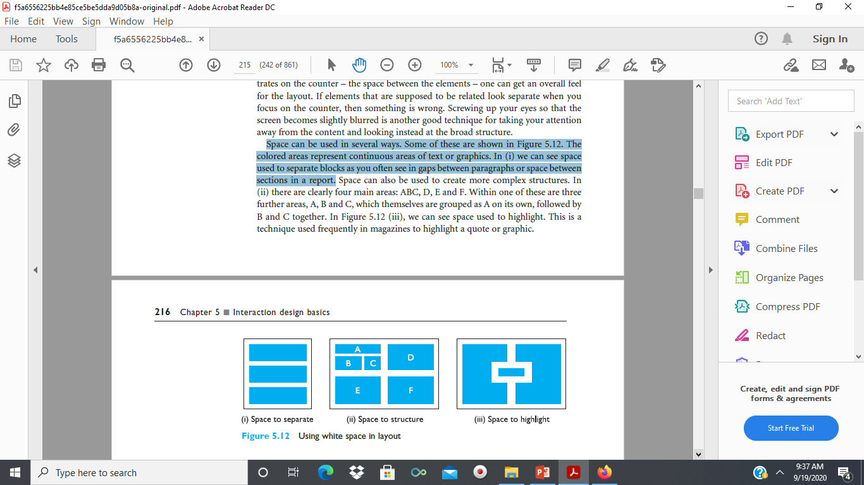
White Spaces
In typography the space between the letters is called the counter.
If one ignores the ‘content’ of a screen and instead concentrates on the counter (the space between the elements), one can get an overall feel of the layout.
If elements that are supposed to be related look separate when you focus on the counter, then something is wrong.
Space can be used in several ways. Some of these are shown in Figure 6
The coloured areas represent continuous areas of text or graphics. In figure 6(i), we can see that, space is used to separate blocks.
Figure 6(i): space used to separate blocks

Slide 37
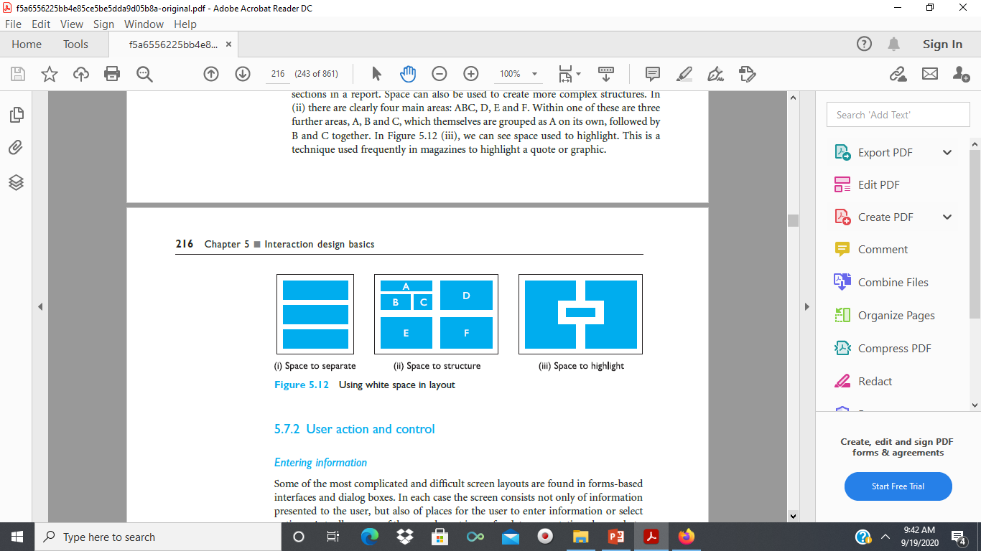

White Spaces
Space can also be used to create more complex structures.
In (ii) there are clearly four main areas: ABC, D, E and F. Within one of these are three further areas, A, B and C, which themselves are grouped as A on its own, followed by B and C together.
(iii), we can see space used to highlight. This is a technique used frequently in magazines to highlight a quote or graphic

Slide 38
Recall the processes in interaction design

Slide 39
Prototyping
Because human situations are complex and designers are not infallible it is likely that our first design will not be perfect!
For this reason, almost all interaction design includes some form of iteration of ideas.
This often starts early on with paper designs and storyboards being demonstrated to colleagues and potential users.
Later in the design process, one might use mockups of physical devices or tools to create prototype versions of software.

Slide 40
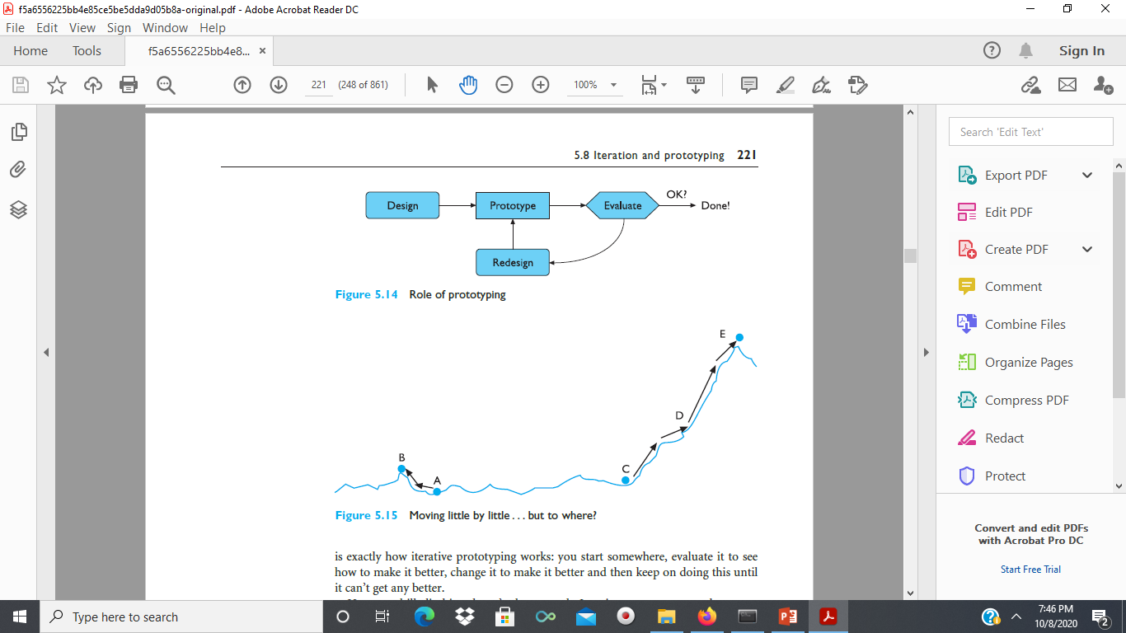
Prototyping
Any of these prototypes, whether paper-based or running software, can then be evaluated to see whether they are acceptable and where there is room for improvement.
The result of evaluating the system will usually be a list of faults or problems and this is followed by a redesign exercise, which is then prototyped, evaluated . .
So iteration and prototyping are the universally accepted ‘best practice’ approach for interaction design
Discussion: What are the advantages and disadvantages of prototyping

Slide 41
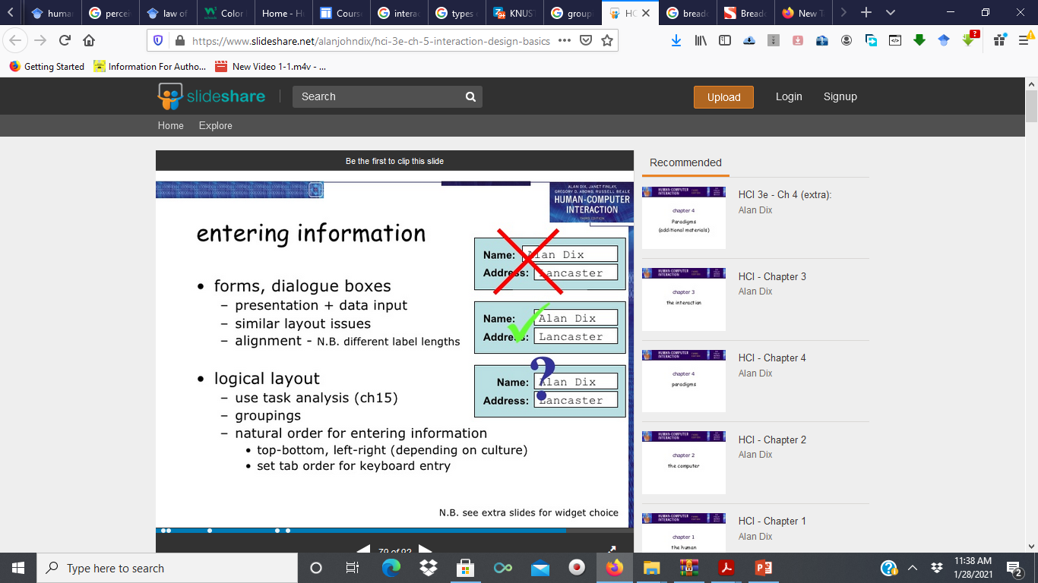
Design Focus

Slide 42
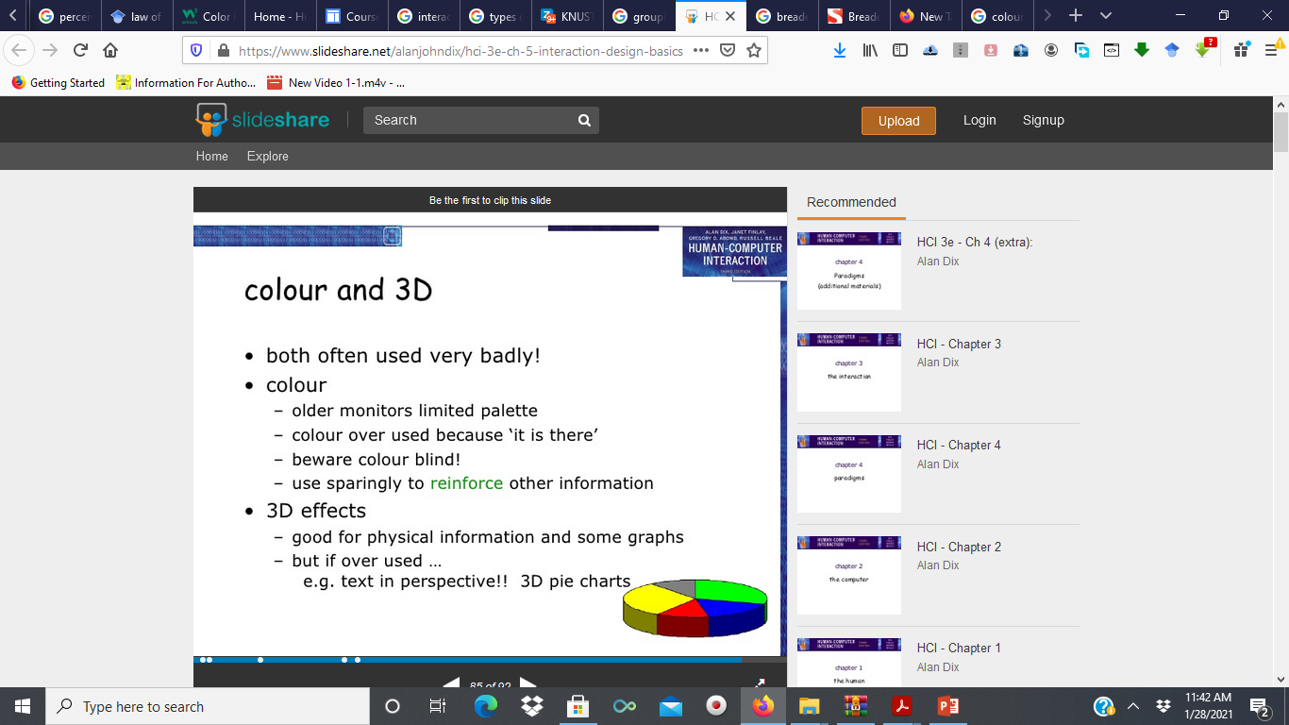
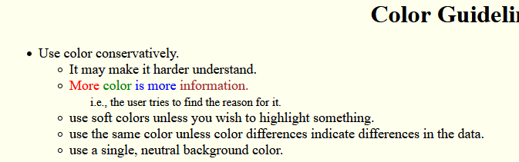
Colour and 3D

Slide 43
Reading assignment
Color Guidelines
https://web.cs.wpi.edu/~dcb/courses/CS3041/Color-guidelines.html

Slide 44
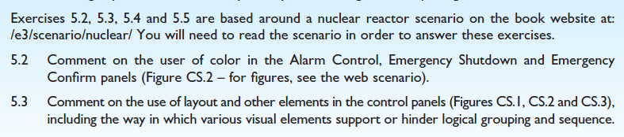
Assignment --- To be submitted via the V-class
Read the scenario at
https://www.hcibook.com/e3/scenario/nuclear/
And use it to answer these questions. Submit on the v-class. Check online for the submission deadline

Slide 45

Group presentation
Read the scenario at
https://www.hcibook.com/e3/scenario/nuclear/
and create a group video presentation addressing these two questions.

Slide 46
Approaches to prototyping
There are three main approaches to prototyping:
Throwaway
Incremental
evolutionary

Slide 47
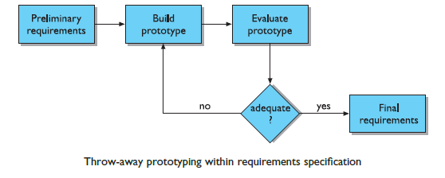
Throw-away prototyping
Throw-away: The prototype is built and tested.
The design knowledge gained from this exercise is used to build the final product, but the actual prototype is discarded.
The Figure on this slide depicts the procedure in using throw-away prototypes to arrive at a final requirements specification in order for the rest of the design process to proceed.

Slide 48
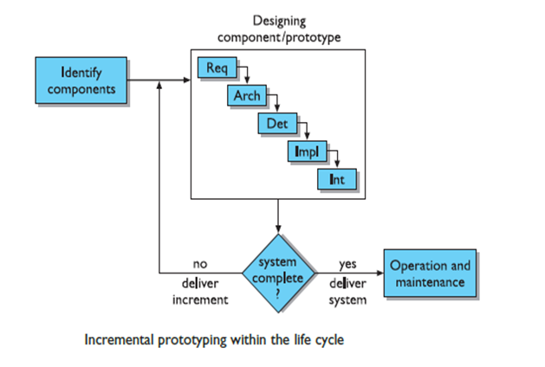
Incremental prototyping
Incremental: The final product is built as separate components, one at a time.
There is one overall design for the final system, but it is partitioned into independent and smaller components.
The final product is then released as a series of products, each subsequent release including one more component.
This is depicted in the Figure on the slide

Slide 49
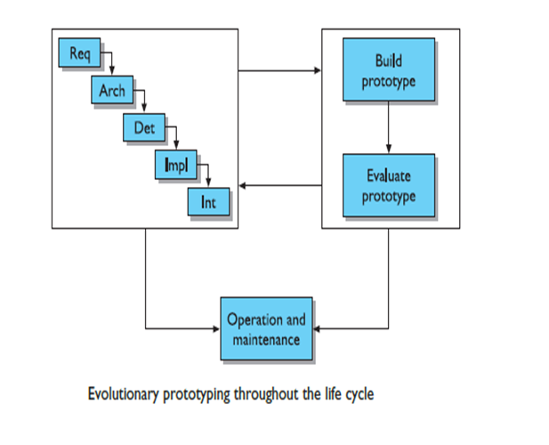
Evolutionary prototyping
Here the prototype is not discarded and serves as the basis for the next iteration of design.
In this case, the actual system is seen as evolving from a very limited initial version to its final release, as depicted in the Figure.
Evolutionary prototyping also fits in well with the modifications which must be made to the system that arise during the operation and maintenance activity in the life cycle.

Slide 50
THANK YOU

